Slide 1
Qualitative Methods: Theory & Practice
8. Content Analysis
Jess Palka
16.06.2025
jessica.palka@uni-due.de

Slide 2
Reflect: Reading
Oleinik (2022) Content Analysis as a Method for Heterodox Economics
Why analyse the content of qualitative data? What can it add to economics?
In your own words, what is abductive reasoning? What does it imply about case selection?
What are the different types of content analysis and which philosophical positions underpin them?
What is the problem with how content analysis is currently applied by institutionalists?
What makes content analysis fitting for heterodox economics?
Tell me something you took particular note of from the article. E.g. something you found interesting, curious or exciting in the article (even negatively – something that you strongly disagreed with).
Notes:
Has anyone used content analysis before?
Is anyone interested in using it?

Slide 3
Content Analysis
Aim
Address the content and/or meaning of “texts” by identifying categories, patterns & themes
Data Sources
Typically written, visual or spoken (transcribed)
Primary: Interviews, focus groups, questionnaires, field notes
Secondary: Books, images, newspapers, audio files, video files, webpages, textbooks
Approach
Researcher needs a strategy or thematic framework for selecting, arranging and analysing the data, i.e.
Basic/Quantitative Content Analysis
Qualitative Content Analysis
Critical Discourse Analysis

Slide 4
Basic Content Analysis
A systematic method for empirically identifying and (statistically) analysing themes of interest
Epistemology
Generally realist, positivist, objectivist → positionality, context unimportant
Strong emphasis on reliability, validity and replication
Inter-coder reliability (see e.g. Campbell et al. 2013)
Research Design
Usually deductive: Literature/theory → preliminary codes
Quantitative: large-N, categorise words, statistically analyse
Population of all materials → relevant sample
Terminology
Sampling frame: define relevant criteria for inclusion (e.g. time, actor, theme, audience)
Code name: label assigned to relevant unit of data (e.g. green growth)
Dictionary: list of codes developed prior (deductive) or following coding (inductive)
Notes:
Quantification: categorise words, statistical summarise e.g. % of text devoted to specific topics
Predict or explain data – how often, how many, how likely, …
Large-N: Condense & summarise texts including hundreds of words and phrases are compressed into a few core categories, themes, or ideas
Descriptive: usually much larger and often more representative samples
Content validity: representativeness—that the content covered by the data and analysis is representative of the larger domain of interest.
Reliability: whether researchers code in the same way, same person consistent results over time and different data
Deductive or Inductive - Exploratory: know little about a topic, develop new knowledge, identify cause-and-effect relationships.

Slide 5
Qualitative Content Analysis
A systematic method for searching out and describing meanings within texts
Approach
Not all meaning is manifest or literal
Meaning is contextual and complex → includes latent content and contextual info
Systematic analysis of texts for not only written content but core themes/ideas
Focus on description rather than theory-development
Epistemology
Can be rather post-positivist or constructionist
Deductive or inductive
Criteria
Validity, reliability and intersubjective coding reliability are emphasised
Still an effort to understand patterns and frequencies, less interpretation
Key evidence may appear only once, or rarely, in collected data
Notes:
Shortcomings of quantitative approach (quantification simplifies but cannot capture certain meanings):
Meaning in texts is not also explicit/manifest (omissions)
is often complex, contextual & needs to be holistically interpreted
meaningful content may only appear once but still be significant

Slide 6
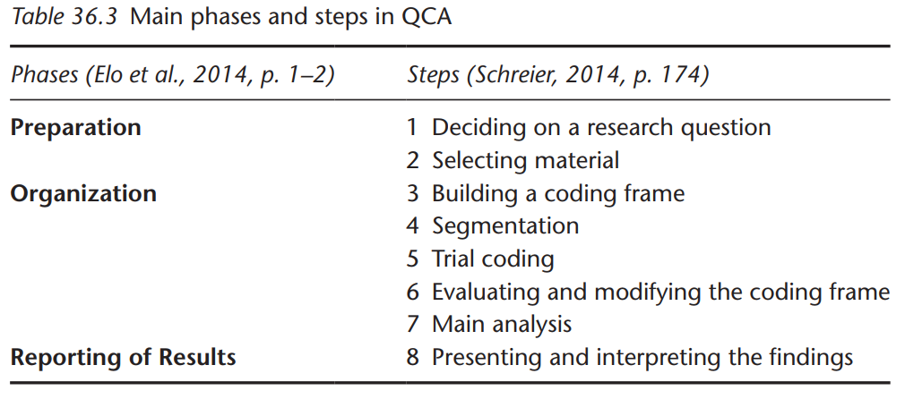
Qualitative Content Analysis
Notes:
Deciding on a research question to guide the project – how and why questions – connect to relevant theories and lit. Outline expectations, biases, subjectivity etc.
Selecting materials: based on relevance to RQ and topic, selecting the right amount for in-depth exploration
Organisation: building, testing and finalising the coding frame
Main analysis: coding frame no long modifiable
Presentation: list of categories & themes, patterns and reoccurrences

Slide 7
Qualitative Content Analysis
A coding frame = a system that will transform the data into meaningful, manageable, specific and smaller units of information (aka codes or categories)
Steps to develop a coding frame
Generate preliminary categories/codes
Structuring: creating main categories
Generating: creating the subcategories for each main category
Define the categories & sub-categories
Name
Description: what is meant by a given category and its features
An example: typical examples
Decision rules (optional – extra information about categories when there is an uncertainty among coders)
Refining, expanding the categories
Structural segmentation: words, sentences, phrases
Trial coding
Apply categories, two rounds of coding, two coders independently, within 10-14 days
Identify gaps/overlaps → modify & finalise coding frame
→ extensive, specific
Notes:
Generating codes: At least one main category (topic of interest) and at least two subcategories (what is said about the main category)
Define categories: extensive for subcategories to boost specificity in coding
Revising, updating, and streamlining the coding frame structure: segmentation makes data searchable, manageable, interpretable
Trial coding: independently code, around the same point in time, twice -> identify overlaps/discrepencies in subcategories, modify & finalise coding frame

Slide 8
Critical Discourse Analysis
Approach
Focus on symbolic communication, meaning, context & relations to other social elements
E.g. power relations, ideologies, institutions, social identities
Self-reflective and critically reflexive knowledge
To understand and explain socially structured systems of power and domination
Epistemology
Constructionist or interpretivist foundation
Normative and explanatory
Deductive or inductive
Terminology
Discourse: Language in use, shaped by and shaping social structures
Ideology: Systems of meaning that sustain relations of domination
Hegemony: Dominance maintained through consent and discourse, not just coercion
Criteria
Triangulation, transparency of the process, reflexivity
Notes:
Reflexive: The researcher’s purpose & context shapes the understanding of words
Normative critique: doesn’t simply describe but rather evaluates realities, assesses how they meet certain values e.g. justice
Explanatory: doesn’t just describe reality but seeks to explain e.g. as the result of existing structures/mechanisms/forces e.g. inequality of wealth as a product of capitalism
Triangulation: Confirm interpretations by comparing to other forms of data e.g. events

Slide 9
Class Activity
“Political Guidelines for the Next European Commission 2024−2029”
Three groups to answer three RQs
Ecological Economists
Neoclassical Economists
Feminist Economists
Develop codes
Themes
Stakeholders
Policy Instruments
Analyse patterns & discursive strategies
How often do your codes occur and with relation to what?
Are there clear interconnections, contradictions, hierarchies?
Discuss & reflect
How are power and legitimacy constructed?
How are sustainability objectives prioritised?
How is economic growth framed?
How are issues of social justice addressed?
Nature, climate, growth, efficiency, gender, Global S
Government, industry, NGOs, citizens
Taxes, subsidies, market mechanisms, redistribution
Notes:
Three groups RQs: e.g.
Eco: ecological and sustainability objectives? nature, sustainable, green, circular, climate, biodiversity, net-zero,
Neo: How is economic growth framed? growth, efficiency, competition, innovation, markets
Develop initial codes:
Fem: Stakeholders and social justice? E.g. gender, marginalised, intersectionality, global south
Themes: Sustainability, Economic Growth, Social Equity
Stakeholders: Government, Industry, NGOs, Citizens, Consumers, Marginalised Groups, etc.
Policy Instruments: Regulations, Incentives, Subsidies, Taxes, Market Mechanisms, etc.

Slide 10
Seminar Feedback
Please take a few minutes to complete the teaching reflection questionnaire.
Your feedback is vital not only for improving the course but also for demonstrating its value and impact to the university.
Notes:
Positive comments and thoughtful suggestions will help build the case for offering this course again in future years.
https://lehrevaluation.zhqe.uni-due.de/evasys/online.php?pswd=K58MA

Slide 11
Sources
Campbell, J. L., Quincy, C., Osserman, J., & Pedersen, O. K. (2013). Coding In-depth Semistructured Interviews: Problems of Unitization and Intercoder Reliability and Agreement. Sociological Methods & Research, 42(3), 294-320. https://doi.org/10.1177/0049124113500475
Drisko, J., & Maschi, T. (2015). Content Analysis. Oxford University Press.
Handford, M., & Gee, J.P. (Eds.). (2023). The Routledge Handbook of Discourse Analysis (2nd ed.). Routledge. https://doi.org/10.4324/9781003035244
O’Leary, Z. (2004). The Essential Guide to Doing Research. SAGE.
Oleinik, A. (2022). Content Analysis as a Method for Heterodox Economics. Journal of Economic Issues, 56(1), 259–280. https://doi.org/10.1080/00213624.2022.2025730
Selvi, A. F. (2019). Qualitative content analysis. In The Routledge Handbook of Research Methods in Applied Linguistics. Routledge.

