Slide 1
Qualitative Methods: Theory & Practice
2. Research Design
Jess Palka
28.04.2025
jessica.palka@uni-due.de

Slide 2
Reflect: Introductions
Broad interests – interviews, focus groups, mixed methods, content analysis, ethnography, …
And experiences – interviews, grounded theory, discourse analysis, narrative analysis, …
To answer big questions – democracy, work, sustainable transitions, fairness, social justice, …
Online: interaction, conversation, respect, interest, …
Disagreements: understanding, reasoning, differences, learning, productive discussion, …

Slide 3
Reflect: Pickbourn and Ramnarain (2016)
How can methodological rigour be ensured in qualitative research?
What is the “double standard” of data quality and how can it be addressed?
What is causal heterogeneity and how is it relevant to qualitative research?
Can quantitative and qualitative methods be meaningfully combined?
What are the practical impediments to integrating methods in economics?
"While qualitative research emphasizes understanding the world from the perspective of the researched, letting respondents tell their story does not necessarily mean taking everything they say at face value." (p.83)
Notes:
thick description, 2. audit/transparency, 3. negative case analysis, 4. narrative analysis, 5. triangulation, 6. reflexivity/positionality
Quant critique: respondents may be untruthful, unaware. Qual response: double standard, can also arise with quantitative research but data collection and analysis (and often who is responsible for them) are separated. Address through appropriate framing and prompts, choosing a suitable mode of research, ethical ways of asking sensitive questions, how to build trust between researcher and researched (e.g. anonymity, confidentiality, informed consent, emphasising research value).
Interviews - can ask for clarification, details, examples. Cross check different information/data sources (triangulation)
Causal heterogeneity = same factors can produce different outcomes, inconsistent causal relationships.
1. No, too different ontologies and epistemologies (subjectivity/objectivity) 2. Yes, the divide is arbitrary and there's actually substantial overlap (quant collection can create qual data, and vice versa. All research grounded in social context.) 3. Yes, practical grounds for mixed methods guided by the research question (pragmatism, no superior technique but more useful is some contexts) 4. Yes, there is an epistemological grounding for mixed methods (critical realism: open system ontology, "no single method can generate certain knowledge about the real world")
Specialisation, legitimacy, publishing

Slide 4
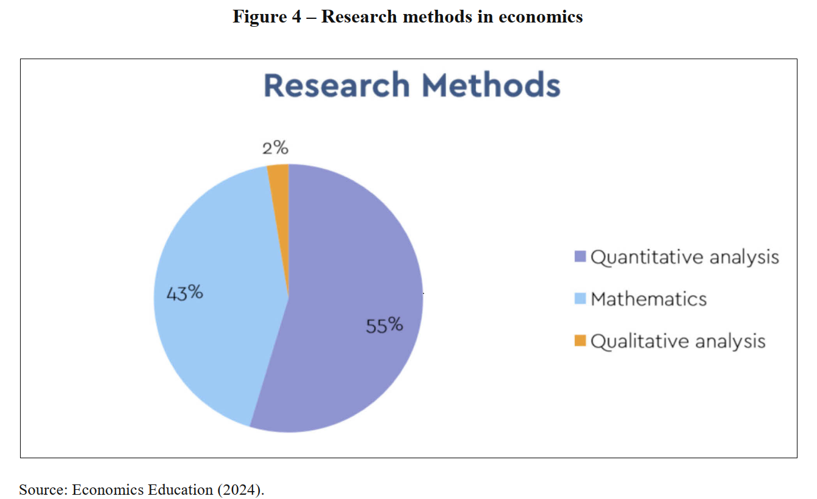
Reflect: Qualitative Methods in Econ
Conte (p. 88, 2024)
Notes:
Convincing arguments for: subjective perspectives, complexity, depth, discovery. Isabell: overemphasis on theory-building. Finn: career effects, methodological critique.
Definitions: Flexible, subjective, discussion, specific research methods vs. overall philosophy?
Assumptions: Subjective vs. objective knowledge.
Problems with applying quant standards: Fundamentally different? - What does this mean for mixed methods?
Legitimate arguments against, how to address? Cost, time, uncertainty, resources, training, …
Resistance (personal barriers?): No courses ←→ no jobs
Your disciplinary biases: Difference in sociology? Other fields? Isabell: subjectivity – are we even asking the right questions? Leah: challenging biases/expectations. Eva: molecular biology?
Shifting views/role: Jana: taking the initiative to learn. Isa/Leah/Maddie: "real-world economics" – “lived experiences” Isa: econ not working, connect to social sciences. Finn: echo chambers, bubbles, disconnection, post-science.

Slide 5
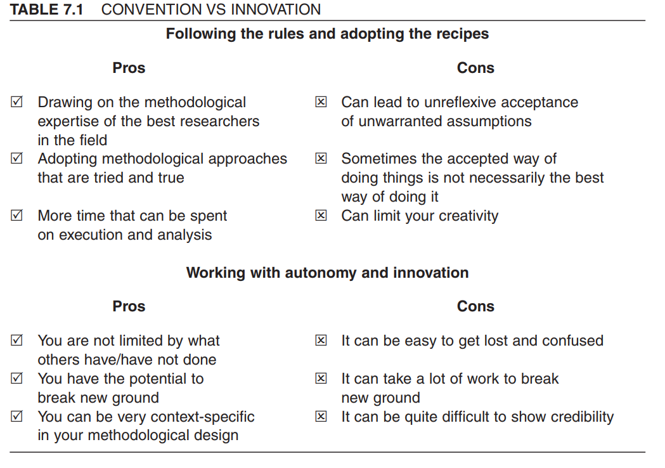
Doing things differently?
O’Leary (p. 88, 2004)

Slide 6
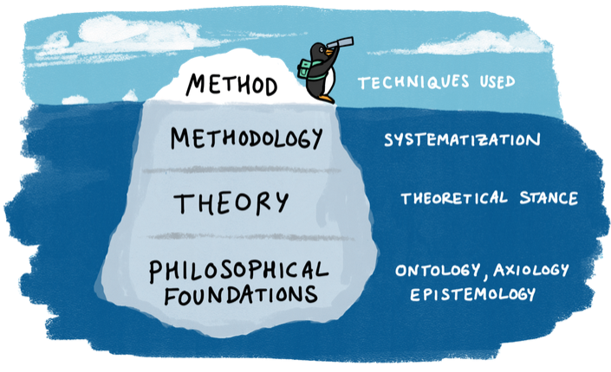
Research Method & Philosophical Foundations
Farrow et al (p. 9, 2020)

Slide 7
Research Design
Daniel, Harland & Wald (p. 23, 2024)

Slide 8
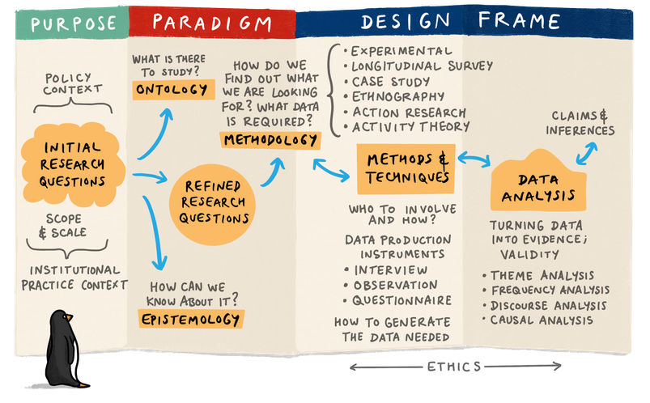
The Research Design Process
Farrow et al (2020)
Notes:
the starting point will usually be a research question framed within a particular (policy and practice) context and paradigm
This informs the potential scope and scale of the project: How would your choice of research topic influence your ontological and epistemological assumptions?
Choose research paradigm: thinking about the ontological and epistemological elements.
Reflect on the nature of the research question; the kind of data it is possible to collect; and work previously done in the area under consideration.
Design phase: consult relevant literature and contributions by others.
Choose method Conduct analysis

Slide 9
Ontology
The beliefs one has about a specific body of knowledge and particular ways of knowing.
What is there (to know)?
Is there an objective reality ‘out there’?
Do we construct reality (or realities)?
Is the world made up of separate parts, or is it one whole system?
What types of things are there?
Notes:
Means: “rational discourse about being”
Underlies our experiences of the world and our beliefs about it.
Before we can study a phenomenon we need to define it. Ontology determines what constitutes validity in a particular study – what is “truth”?

Slide 10
Epistemology
The scientific procedures used to empirically (using data) or logically and philosophically (using concepts/theories) investigate a problem.
How we can come to know (it)?
What is knowledge?
Can we objectively observe reality?
Is knowledge the result of our interpretations and experiences?
Where do you we start? (with logic, theory, empirical observations…?)
Notes:
Means: “rational discourse about knowledge”
Epistemology is closely connected to method - both concern knowledge creation and validation. Research methods = stripped down, purpose-specific epistemologies.

Slide 11
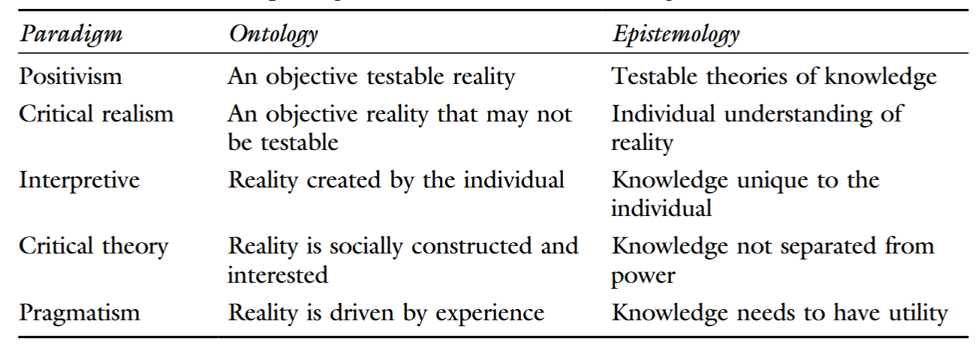
Paradigms
Daniel, Harland & Wald (p. 24, 2024)
Notes:
Positivism:
Social sciences are in many ways similar to other (physical) sciences.
Rooted in the scientific revolution of the Enlightenment.
The world exists as an objective entity -> outside of the mind of the observer, knowable in its entirety.
The task of the researcher is to describe and analyse this reality.
Deep epistemological separation between the researcher and the object of research -> can observe it in a neutral way what is “true”, not just the opinion of the researcher -> context is not important
there are systematic rules and regularities, law-like relationships and mechanisms governing the object of study -> empirical research.
Positivism downplays any gap between our experiences of the world and the way the world really is and takes it that we determine objective “facts” through the correct methodological combination of observation and analysis.
Quantitative data collection -> overcomes individual biases of the researcher.
high standards of validity and reliability supported by evidence
Interpretavism:
there are features of human experience that cannot objectively be “known”
-> Subjective meaning is at the core
Since human beings are ‘meaningful’ actors, scholars must aim at discovering the meanings that motivate their actions rather than relying on universal laws external to the actors.
impossible to understand historical events or social phenomena without looking at the perceptions individuals have of the world outside.
a world of actors with imperfect knowledge and complex motivations,
themselves formed through complex cultural and social influences, but retaining a degree of free will and judgement.
Interpretation depends on values/concerns of the research themselves
Post-positivism:
Positivist assumptions are relaxed.
Reality is still considered to be objective (external to human minds), but it is only imperfectly knowable.
some phenomena are not governed by causal laws but, at best, by probabilistic ones, accept a degree of uncertainty.
experiences truths are necessarily imperfect because they are ameliorated by our values and experiences.
mixed methods and triangulation of quantitative and qualitative data, accepting the problematic nature of “objective” truths
Critical realist epistemology
A popular form of Post-Positivism, lies between Positivism and Interpretivism.
there is a real material world but that our knowledge of it is often socially conditioned and subject to challenge and reinterpretation.
There are mechanisms governing human affairs that may be unobserved and unobservable -> can’t be discounted

Slide 12
Paradigms cont.
Positivism
One objective world, can be observed
Pursues an objective search for facts
Separation of “knower” and “known”
Context is not important
Universal law-like mechanisms governing the object of study.
Employs empirical or analytical approaches
Quantitative data collection → overcomes individual biases of the researcher
High standards of validity and reliability, supported by evidence
Interpretivism
Realities are multiple and socially constructed
→ subjective meaning at the core
Inevitable interaction between the researcher and research participants
Context is vital for knowledge and knowing
Individual rather than universal laws
Knowledge is created by the findings, can be value laden
→ values need to be made explicit
Interpretation depends on values/concerns of the research themselves
Notes:
What assumptions about reality do you personally find most convincing: that it is objective, or that it is socially constructed? Why?
Can researchers ever truly observe a social phenomenon without influencing it or being influenced by it? Why or why not?
Is striving for complete neutrality in social research a helpful or misleading goal? If all research is shaped by the researcher’s interpretations and values (as Interpretivists suggest), what strategies can we use to improve the credibility of research?

Slide 13
Axiology
The values that focus and motivate our research.
What do we value (in research)?
What matters? Why do research at all?
How does it contribute to human wellbeing?
What roles and responsibilities do researchers have (to readers, peers, participants, …) ?
Which (conscious and unconscious) values shape, and are reproduced by, the research process?
Notes:
Means: “rational discourse about values”
AKA ethics, positionality, or a commitment to social justice You might not consciously engage with values in a research project, but they are still there.
Can include a commitment to scientific rigour, or to always act ethically as a researcher. Explicit: critical theory

Slide 14
Methodology
The overall system/approach which connects what you believe exists (ontology) and how you think it can be known (epistemology) to the strategies you choose to investigate it.
How do we discover/create knowledge?
How should we study the phenomenon?
What kind of data do we need to answer our research question?
What role does the researcher play in the research process?
Is it appropriate to use qualitative, quantitative, or mixed approaches?
How do our ontological and epistemological positions shape our methods?
Notes:
Your methodology guides:
What kind of evidence you gather
How you design your research (e.g. case study, ethnography, experiment)
How you justify your approach to others (academically or professionally)

Slide 15
Methods
The concrete/specific tools, techniques and procedures we employ to acquire knowledge.
What tools do we use?
What data sources are available or can be generated?
How will we gather data? (e.g. interviews, focus groups, documents, observations)
Who will be involved? How will participants be selected and approached? Why?
How will data be collected, recorded, managed, and stored securely?
What is the plan for data analysis? (e.g. thematic analysis, grounded theory, QCA)
How will we ensure ethical research practice? (informed consent, confidentiality, etc.)
What will be the basis for evaluating rigour and trustworthiness? (e.g. credibility, dependability, triangulation)

Slide 16
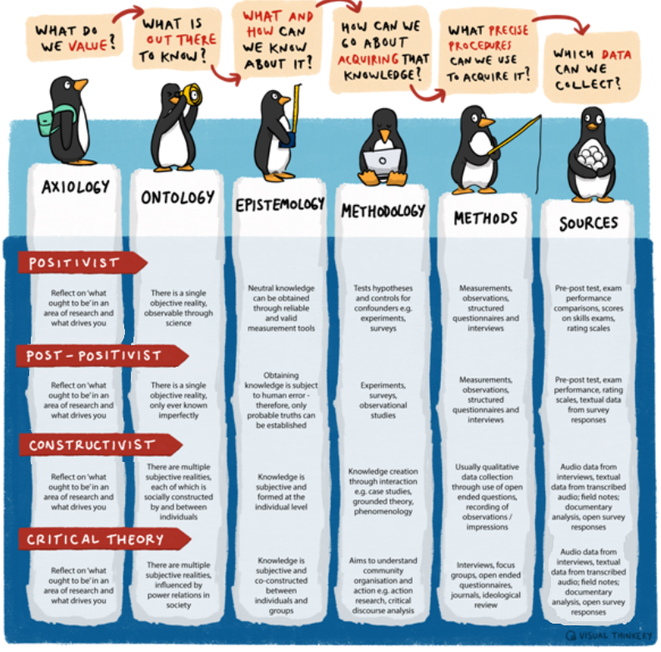
What do you value enough to investigate?
What do you believe can be known about it?
How do you believe that this phenomena can be best understood?
What is your overall guiding strategy for the research?
Which specific tools, techniques or procedures will you employ?
Where can you find the data and how will you analyse it?
Farrow et al (2020)
Notes:
All of these elements need to inform the design of research.
Helpful to keep in mind the ultimate goal of your project so you can design your specific activity around reaching this point. 4. Methodology: how is your ontology/epistemology/axiology connected to/reflected by your methods?
5. Methods: Can a researcher really combine quantitative and qualitative methods without philosophical contradictions? Why or why not?

Slide 17
Online Tasks & Engagement
Choose a philosophical position:
Positivism, Critical Realism, or Interpretivism
In groups, on Moodle (Etherpad):
Outline ontological, epistemological, axiological, methodological assumptions (brainstorming, dot points, creative?)
Interactions:
Everyone comments on the other two groups’ responses with questions, critiques, suggestions, …

Slide 18
Sources
Conte, L. (2024). Qualitative economics: Integrating qualitative research methods into economic analysis. https://doi.org/10.51363/unifr.eth.2024.022
Daniel, B.K., Harland, T., & Wald, N. (p. 24, 2024). Higher Education Research Methodology: A Step-by-Step Guide to the Research Process (2nd ed.). Routledge. https://doi.org/10.4324/9781003473459
Farrow, R., & Mathers, B. (2020). Conceptualising Research Methodology for Doctoral Researchers in Open Education (with penguins). International Journal of Management and Applied Research, 7(3), Article 3.
O’Leary, Z. (2004). The Essential Guide to Doing Research. SAGE.
Della Porta D. & Keating M. How many approaches in the social sciences? An epistemological introduction. In: Della Porta D, Keating M, eds. Approaches and Methodologies in the Social Sciences: A Pluralist Perspective. Cambridge University Press; 2008:19-39.

